Slide 1
Using logistic regression to predict NBA All Stars
Dan Kern

Slide 2
The challenge
A grandfather challenged his grandson to a competition: Predict the 2016-2017 NBA all star team members ahead of the announcement.
The grandfather’s son asked himself: Could a mathematical model select the all star team members as well as his father or son?
He used publically available data and free software to perform a logistic regression. Source: https://sports.yahoo.com/nba/stats/byposition?pos=PG%2CSG%2CG%2CGF%2CSF%2CPF%2CF%2CFC%2CC&sort=25&qualified=1&conference=NBA&year=season_2015

Slide 3
Approach
Think about appropriate data
Find and prep the data (player and team stats from the previous season)
Select the candidate predictor variables (a.k.a., x variables, features)
Run logistic regression in R
Select best model

Slide 4
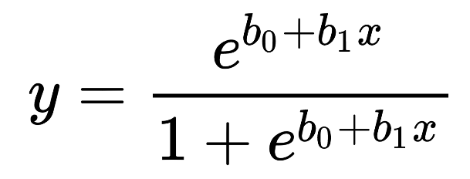
A little about logistic regression
Output (y-variable) is binary, i.e., 1 vs. 0; y vs. n
Input (x-variables) can be continuous or discrete
The model is a set of coefficients (the “b’s” below) that can be used in an equation to estimate the Y given values for X.

Slide 5
Data
Training data = 2014 – 2015 season NBA data
Candidate Features (x-variables)
Season | Use
2014-15 | Train
2015-16 | Predict
2016-17 | Not available
Player Stats |  |  | Team Stats
Games Played (GP) | Free Throws Percent (FT_Pct) |  | Wins (W)
MinPlayed | Rebounds_Off |  | Losses (L)
Baskets Made (FG_M) | Rebounds_Def |  | W/L%
Baskets Attempted (FG_A) | Rebounds_Tot |  | MOV
Shooting Percent (FG_Pct) | Assists (Ast) |  | Offensive Rating (Ortg)
3 Pointers Made (3Pt_M) | Turnovers (TO) |  | Defensive Rating (DRtg)
3 Pointers attempted (3Pt_A) | Steals (Stl) |  | NRtg
3 Pointers Percent (3Pt_Pct) | Blocks (Blk) |  | MOV/A
Free Throws Made (FT_M) | Fouls (PF) |  | ORtg/A
Free Throws Attempted (FT_A) | Points per Game (PPG) |  | DRtg/A
 |  |  | NRtg/A

Slide 6
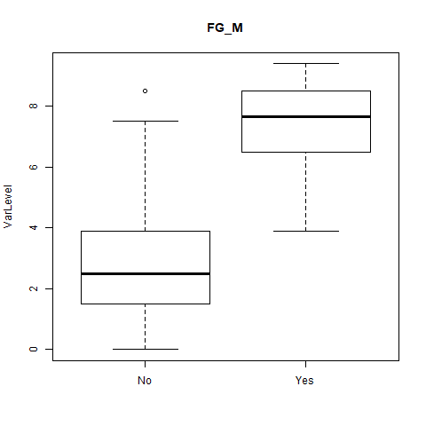
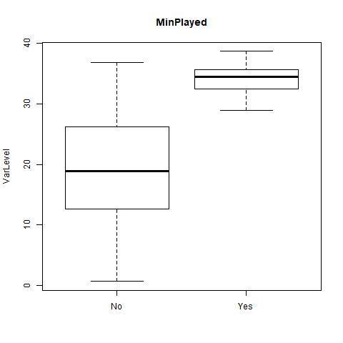
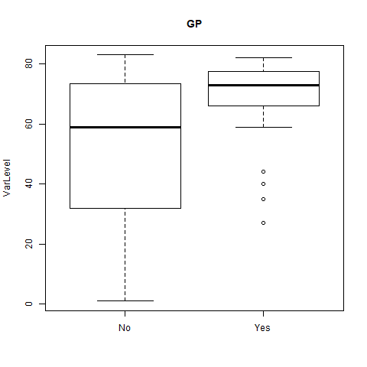
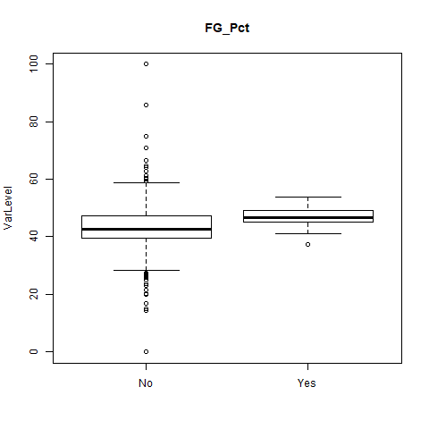
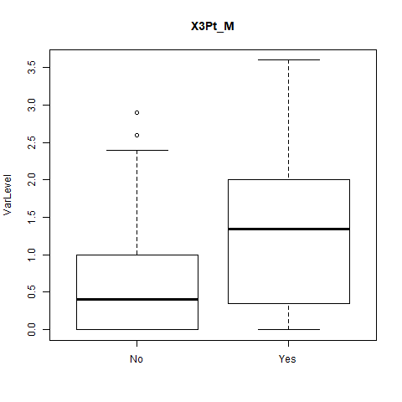
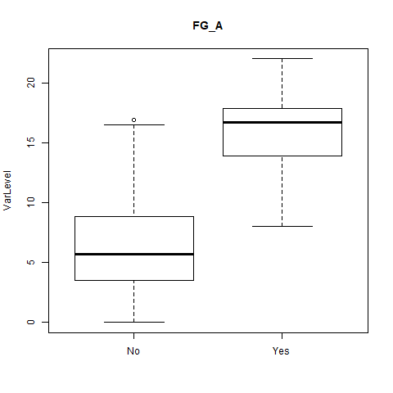
Feature selection using box plots

Slide 7
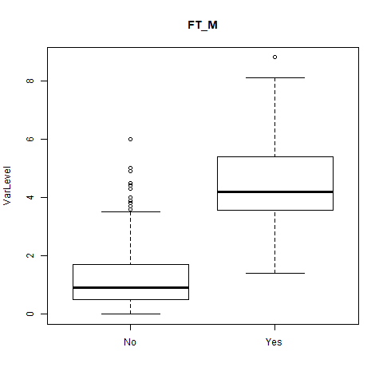
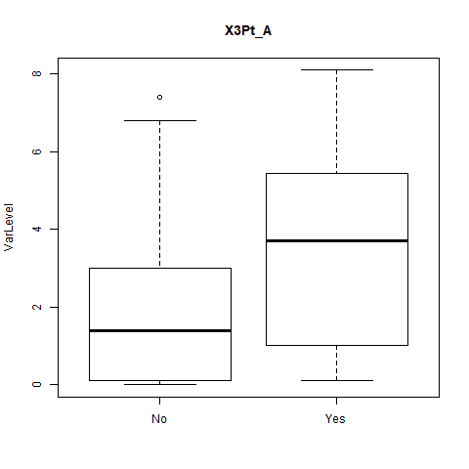
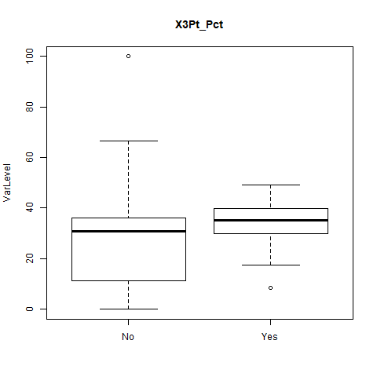
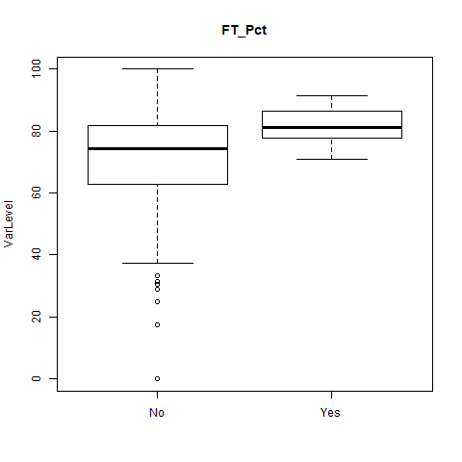
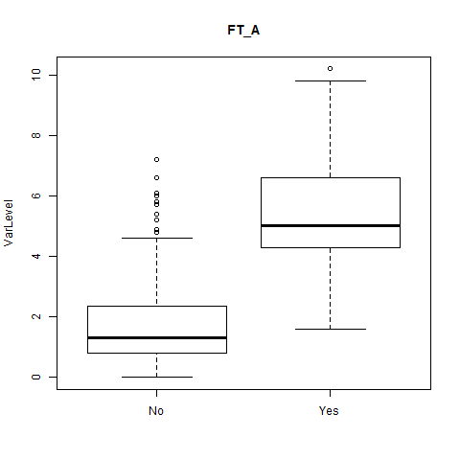
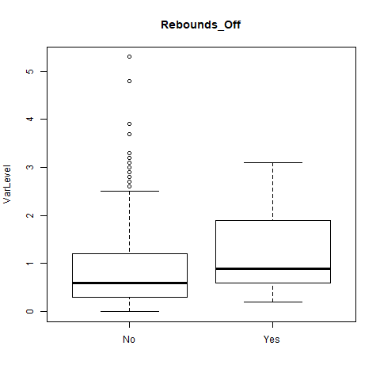
Box plots (Set 2)

Slide 8
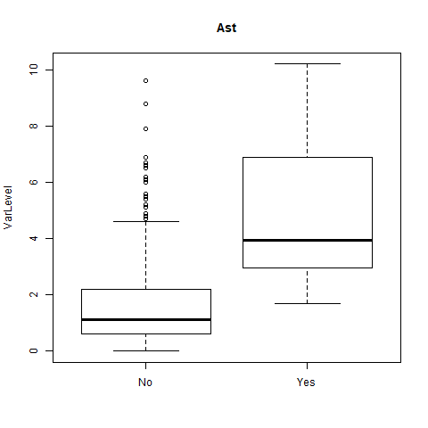
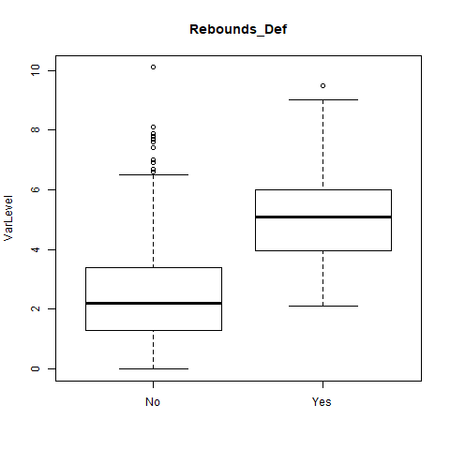
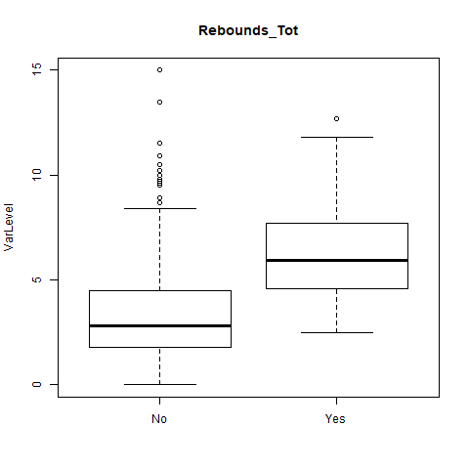
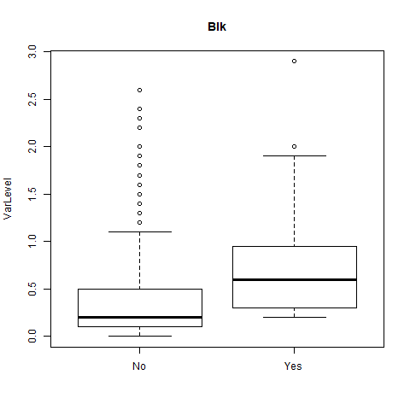
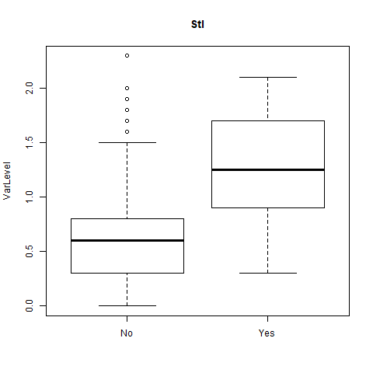
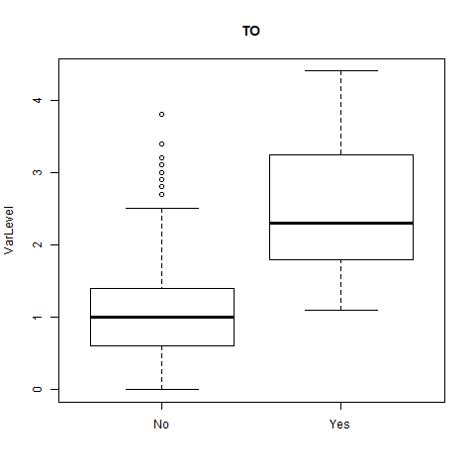
Box plots (Set 3)

Slide 9
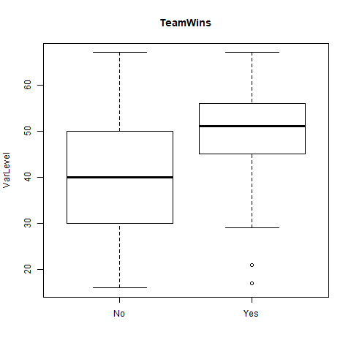
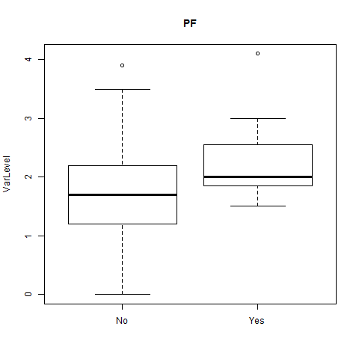
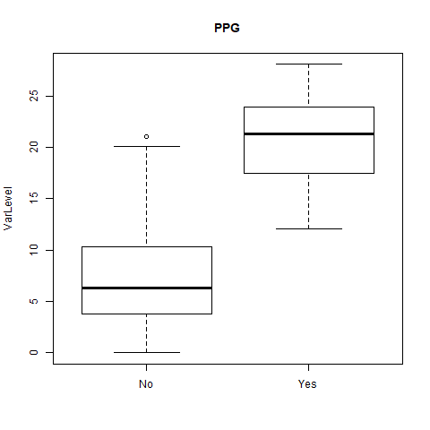
Box plots (Set 4)

Slide 10
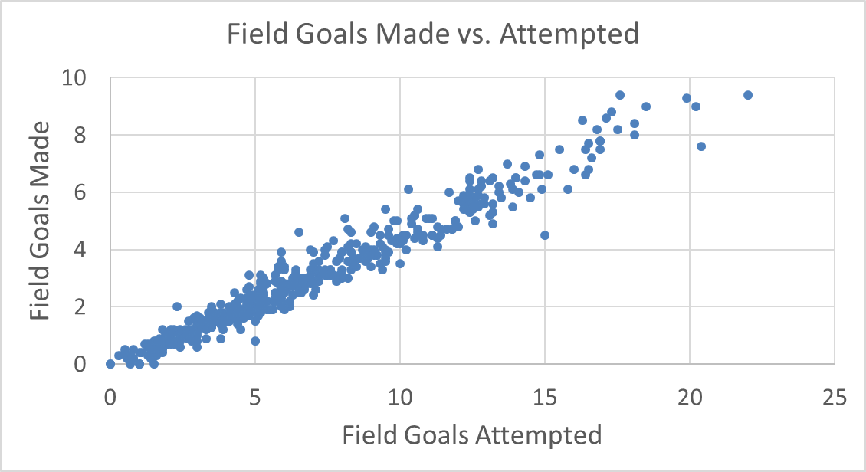
Correlation example
Correlation means the values of two or more variables “move together”

Slide 11
Correlation
Correlation matrix represented by a heat map shows variables that are correlated. The warmer colors show variables that are more correlated.
 | GP | MinPlayed | FG_M | FG_A | FG_Pct | 3Pt_M | 3Pt_A | 3Pt_Pct | FT_M | FT_A | FT_Pct | Rebounds_Off | Rebounds_Def | Rebounds_Tot | Ast | TO | Stl | Blk | PF | PPG
GP | 1.00
MinPlayed | 0.65 | 1.00
FG_M | 0.55 | 0.90 | 1.00
FG_A | 0.51 | 0.90 | 0.98 | 1.00
FG_Pct | 0.34 | 0.23 | 0.29 | 0.15 | 1.00
3Pt_M | 0.31 | 0.53 | 0.47 | 0.56 | -0.11 | 1.00
3Pt_A | 0.29 | 0.53 | 0.46 | 0.58 | -0.17 | 0.98 | 1.00
3Pt_Pct | 0.23 | 0.34 | 0.29 | 0.35 | -0.10 | 0.62 | 0.59 | 1.00
FT_M | 0.39 | 0.74 | 0.84 | 0.84 | 0.20 | 0.36 | 0.36 | 0.20 | 1.00
FT_A | 0.39 | 0.74 | 0.84 | 0.82 | 0.24 | 0.28 | 0.28 | 0.13 | 0.98 | 1.00
FT_Pct | 0.36 | 0.35 | 0.35 | 0.36 | 0.19 | 0.37 | 0.36 | 0.33 | 0.34 | 0.24 | 1.00
Rebounds_Off | 0.36 | 0.41 | 0.41 | 0.29 | 0.45 | -0.31 | -0.33 | -0.32 | 0.34 | 0.44 | -0.03 | 1.00
Rebounds_Def | 0.53 | 0.73 | 0.71 | 0.63 | 0.40 | 0.06 | 0.04 | -0.01 | 0.59 | 0.66 | 0.13 | 0.79 | 1.00
Rebounds_Tot | 0.50 | 0.65 | 0.65 | 0.55 | 0.44 | -0.06 | -0.08 | -0.11 | 0.53 | 0.62 | 0.08 | 0.90 | 0.98 | 1.00
Ast | 0.34 | 0.65 | 0.62 | 0.67 | 0.00 | 0.45 | 0.48 | 0.32 | 0.59 | 0.56 | 0.25 | -0.05 | 0.28 | 0.19 | 1.00
TO | 0.41 | 0.79 | 0.80 | 0.82 | 0.15 | 0.39 | 0.41 | 0.25 | 0.77 | 0.78 | 0.25 | 0.26 | 0.55 | 0.48 | 0.82 | 1.00
Stl | 0.42 | 0.75 | 0.66 | 0.70 | 0.07 | 0.47 | 0.50 | 0.31 | 0.61 | 0.60 | 0.26 | 0.16 | 0.44 | 0.37 | 0.69 | 0.72 | 1.00
Blk | 0.31 | 0.36 | 0.37 | 0.26 | 0.41 | -0.20 | -0.23 | -0.24 | 0.30 | 0.38 | -0.02 | 0.73 | 0.69 | 0.74 | -0.04 | 0.21 | 0.15 | 1.00
PF | 0.55 | 0.70 | 0.60 | 0.56 | 0.31 | 0.18 | 0.18 | 0.04 | 0.46 | 0.51 | 0.16 | 0.59 | 0.70 | 0.70 | 0.34 | 0.57 | 0.52 | 0.52 | 1.00
PPG | 0.53 | 0.89 | 0.99 | 0.98 | 0.25 | 0.55 | 0.54 | 0.34 | 0.89 | 0.87 | 0.38 | 0.34 | 0.67 | 0.59 | 0.65 | 0.81 | 0.69 | 0.32 | 0.57 | 1.00
We need to be careful not to include multiple variables that are correlated with each other in our model. That will lead to over counting or over emphasizing the effect of the variable.

Slide 12
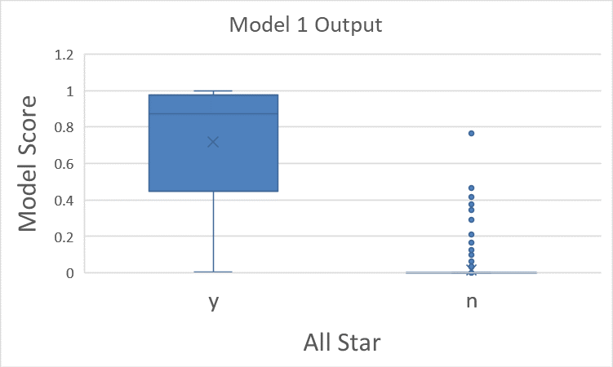
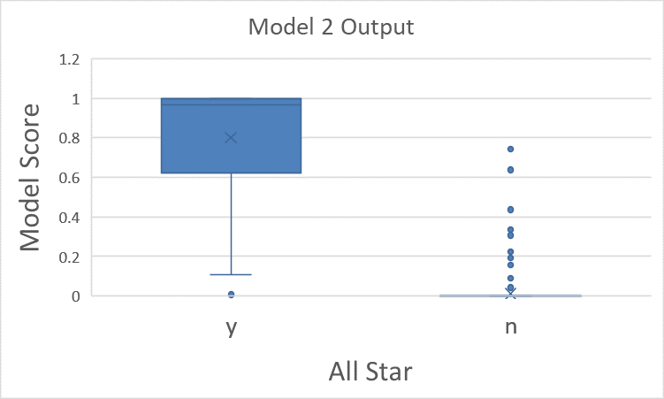
Top 2 Models
Logistic Regression Model
lrm(formula = AllStar2015_16 ~ PPG + Ast + Blk, data = mydata)
Model Likelihood Discrimination Rank Discrim.
Ratio Test Indexes Indexes
Obs 492 LR chi2 159.53 R2 0.783 C 0.988
0 464 d.f. 3 g 5.425 Dxy 0.975
1 28 Pr(> chi2) <0.0001 gr 227.065 gamma 0.976
max |deriv| 9e-05 gp 0.105 tau-a 0.105
Brier 0.015
Coef S.E. Wald Z Pr(>|Z|)
Intercept -16.9940 3.2903 -5.16 <0.0001
PPG 0.6881 0.1444 4.76 <0.0001
Ast 0.5729 0.2079 2.76 0.0059
Blk 2.5679 0.7923 3.24 0.0012
Logistic Regression Model
lrm(formula = AllStar2015_16 ~ PPG + Ast + Blk + TeamWins, data = mydata)
Model Likelihood Discrimination Rank Discrim.
Ratio Test Indexes Indexes
Obs 492 LR chi2 176.58 R2 0.852 C 0.995
0 464 d.f. 4 g 8.094 Dxy 0.990
1 28 Pr(> chi2) <0.0001 gr 3273.564 gamma 0.990
max |deriv| 0.0005 gp 0.107 tau-a 0.106
Brier 0.011
Coef S.E. Wald Z Pr(>|Z|)
Intercept -31.1292 7.7745 -4.00 <0.0001
PPG 1.0570 0.2726 3.88 0.0001
Ast 0.5617 0.2705 2.08 0.0378
Blk 2.6493 1.0481 2.53 0.0115
TeamWins 0.1724 0.0556 3.10 0.0019

Slide 13
Comparing the top 2 models
Predictor Variable & R² | Model 1 | Model 2
PPG – Points per game | Y | Y
Ast – Assists | Y | Y
Blk – Blocks | Y | Y
Team Wins | N | Y
R² | 0.783 | 0.852

Slide 14
Predicting 2017 NBA all stars with “Model 2” WESTERN CONFERENCE
Rank | Name | Team | Conf | AllStar 2017 | AllStarStarter | Model2: FittedValue
1 | Stephen Curry | GS | West | 1 | 1 | 1.00
2 | Kevin Durant | OKC | West | 1 | 1 | 1.00
3 | James Harden | HOU | West | 1 | 1 | 1.00
4 | Russell Westbrook | OKC | West | 1 | 0 | 1.00
5 | DeMarcus Cousins | SAC | West | 1 | 0 | 1.00
6 | Damian Lillard | POR | West |  |  | 1.00
7 | Klay Thompson | GS | West | 1 | 0 | 1.00
8 | Kawhi Leonard | SA | West | 1 | 1 | 1.00
9 | Anthony Davis | NO | West | 1 | 1 | 1.00
10 | Chris Paul | LAC | West |  |  | 0.99
11 | Blake Griffin | LAC | West |  |  | 0.99
12 | Draymond Green | GS | West | 1 | 0 | 0.98
13 | LaMarcus Aldridge | SA | West |  |  | 0.96
14 | C.J. McCollum | POR | West |  |  | 0.84
15 | Gordon Hayward | UTA | West | 1 | 0 | 0.37
16 | Eric Bledsoe | PHO | West |  |  | 0.36
17 | Marc Gasol | MEM | West | 1 | 0 | 0.32
18 | Karl-Anthony Towns | MIN | West |  |  | 0.24
19 | Andrew Wiggins | MIN | West |  |  | 0.18
20 | Dirk Nowitzki | DAL | West |  |  | 0.16
21 | DeAndre Jordan | LAC | West | 1 | 0 | 0.14

Slide 15
Predicting 2017 NBA all stars with “Model 2” EASTERN CONFERENCE
Rank | Name | Team | Conf | AllStar 2017 | AllStarStarter | Model2: FittedValue
1 | LeBron James | CLE | East | 1 | 1 | 1.00
2 | DeMar DeRozan | TOR | East | 1 | 1 | 1.00
3 | Kyle Lowry | TOR | East | 1 | 0 | 1.00
4 | John Wall | WAS | East | 1 | 0 | 0.99
5 | Paul George | IND | East | 1 | 0 | 0.99
6 | Isaiah Thomas | BOS | East | 1 | 0 | 0.99
7 | Kemba Walker | CHA | East | 1 | 0 | 0.97
8 | Kyrie Irving | CLE | East | 1 | 1 | 0.95
9 | Jimmy Butler | CHI | East | 1 | 1 | 0.92
10 | Hassan Whiteside | MIA | East |  |  | 0.90
11 | Paul Millsap | ATL | East | 1 | 0 | 0.83
12 | Dwyane Wade | MIA | East |  |  | 0.80
13 | Pau Gasol | CHI | East |  |  | 0.76
14 | Carmelo Anthony | NY | East |  |  | 0.75
15 | Chris Bosh | MIA | East |  |  | 0.57
16 | Reggie Jackson | DET | East |  |  | 0.52
17 | Brook Lopez | BKN | East |  |  | 0.47
18 | Al Horford | ATL | East |  |  | 0.27
19 | Dahntay Jones | CLE | East |  |  | 0.24
20 | Nikola Vucevic | ORL | East |  |  | 0.20
21 | Giannis Antetokounmpo | MIL | East | 1 | 1 | 0.19
22 | Kevin Love | CLE | East | 1 | 0 | 0.15

Slide 16
Predictions from “Model 2”
Picked 19 out of 24 of the 2017 NBA all stars
9 Western Conference
10 Eastern Conference
Anything interesting on the previous two slides?
Did anyone get overlooked?
Did some players get selected that did not deserve it?

Slide 17
Summary
Used logistic regression to build a model to predict NBA all star team members
Model showed NBA all stars are likely to be the players who:
Score a lot of points per game
Give teammates assists
Block shots
On a winning team
Model performed very well: Predicted 19 of 24 players

